Slide 1
CSCI U511 01 Operating Systems AKM Jahangir A Majumder, PhD
Fall 2019 - Lecture 5
Sept. 5, 2019
Note: Some slides are adapted from those used by previous instructors and some slides include figures from the textbook.

Slide 2
Review and Learning Outcomes
We will continue to discuss Chap 2: Kernels and Abstraction
We will discuss Processes and Threads today
Interrupts
Upcalls
System call handler
We will have our first quiz today which will cover lectures 1-3
HW 1 key is posted on Blackboard
Please send me your updated proposal and start working on your project

Slide 3
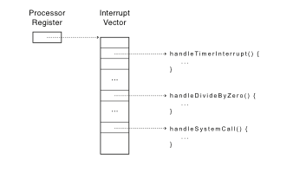
Review: Interrupt Vector
Table set up by OS kernel; pointers to code to run on different events. Lists of kernel routines to handle hardware interrupts, exceptions, and system calls
Notes:
Note: by “processor register” I do not mean %eax. Rather – these are special purpose registers.

Slide 4
Interrupt Stack
Register point to a region of kernel memory
Per-processor, located in kernel (not user) memory
Usually a process/thread has both: kernel and user stack
Why can’t the interrupt handler run on the stack of the interrupted user process?
Reliability
Security
Notes:
What goes in a stack frame?
Frame pointer
Locals
Return address

Slide 5
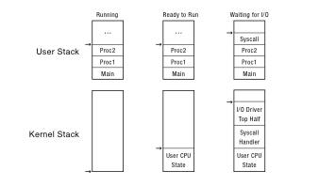
Interrupt Stack: Two stack/process
Notes:
Lots of complexity on this slide. Let’s unpack:
Every process/thread has two stacks. When the process is running, does the kernel stack have anything useful on it? You might think yes – it called into the user program. But actually no – the user program doesn’t return from main.
Need to change this to add “crt0.s” – main returns to crt0.s, and then calls exit.
Best to think of this as multiple personality disorder: sometimes we want to save context, other times not!
When a process is ready to run, but not running – it has its user stack as before, but now I also need a place to store the state that had been in the CPU when it stopped running
When a process is waiting for I/O, it had done a system call, etc.

Slide 6
Device Interrupts
How do device interrupts work?
Where does the CPU run after an interrupt?
What is the interrupt handler written in? C? Java?
What stack does it use?
Is the work the CPU had been doing before the interrupt lost forever?
If not, how does the CPU know how to resume that work?
Notes:
I’m going to answer these questions, kind of as a side light to the rest of the discussion. But they are pretty important!

Slide 7
Interrupt Masking (Deferred)
Interrupt handler runs with interrupts off
Re-enabled when interrupt completes
OS kernel can also turn interrupts off
Eg., when determining the next process/thread to run
On x86
CLI: disable interrupts
STI: enable interrupts
Only applies to the current CPU (on a multicore)

Slide 8
Interrupt Handlers
Non-blocking, run to completion
Minimum necessary to allow device to take next interrupt
Any waiting must be limited duration
Wake up other threads to do any real work
Linux: semaphore
Rest of device driver runs as a kernel thread
Notes:
Skip this slide – too much for the students to get

Slide 9
Case Study: MIPS Interrupt/Trap
Two entry points: translation lookaside buffer (TLB) miss handler, everything else
Save type: syscall, exception, interrupt
And which type of interrupt/exception
Save program counter: where to resume
Save old mode, interruptable bits to status register
Set mode bit to kernel
Set interrupts disabled
For memory faults
Save virtual address and virtual page
Jump to general exception handler

Slide 10
Case Study: x86 Interrupt
Save current stack pointer
Save current program counter
Save current processor status word (condition codes)
Switch to kernel stack; put SP, PC, PSW (PROGRAM STATUS WORD) on stack
Switch to kernel mode
Vector through interrupt table
Interrupt handler saves registers it might clobber

Slide 11
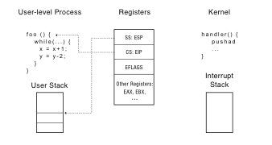
Before Interrupt
The state of the system before an interrupt handler is invoke
SS (Stack segment), ESP (stack pointer), CS (code segment), EIP (program counter)
Notes:
Why does the stack pointer on the x86 have two components?

Slide 12
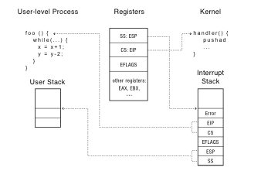
During Interrupt

Slide 13
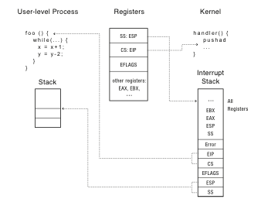
After Interrupt

Slide 14
At end of handler
Handler restores saved registers
Atomically return to interrupted process/thread
Restore program counter
Restore program stack
Restore processor status word/condition codes
Switch to user mode

Slide 15
Upcall: User-level event delivery
Notify user process of some event that needs to be handled right away
Time expiration
Real-time user interface
Time-slice for user-level thread manager
Interrupt delivery for VM player
Asynchronous I/O completion (async/await)
AKA UNIX signals
AKA Windows asynchronous events

Slide 16
Upcalls vs Interrupts
Signal handlers = interrupt vector
Signal stack = interrupt stack
Automatic save/restore registers = transparent resume
Signal masking: signals disabled while in signal handler

Slide 17
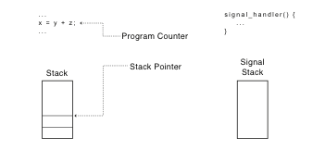
Upcall: Before
The state of the user program and signal handler before UNIX signal (Upcall).
Upcall behave analogously to processor exceptions, but at user level.

Slide 18
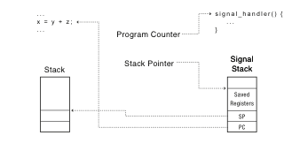
Upcall: During
The state of the user program and signal handler during UNIX signal (Upcall).
The signal stack stores the state of the hardware registers at point where the process was interrupted

Slide 19
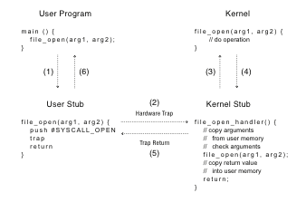

Slide 20
Kernel System Call Handler
Locate arguments
In registers or on user stack
Translate user addresses into kernel addresses
Copy arguments
From user memory into kernel memory
Protect kernel from malicious code evading checks
Validate arguments
Protect kernel from errors in user code
Copy results back into user memory
Translate kernel addresses into user addresses

Slide 21
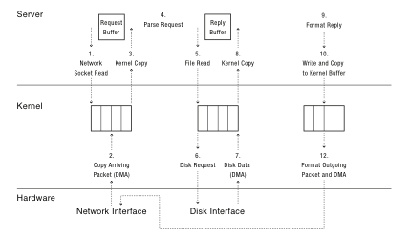

Slide 22
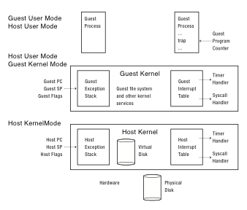
Emulation of user- and kernel- mode transfer for processes running inside VM
Notes:
Apologies: it should be Guest/Host Interrupt Stack to be consistent with the other figures.

Slide 23
User-Level Virtual Machine
How does VM Player work?
Runs as a user-level application
How does it catch privileged instructions, interrupts, device I/O?
Installs kernel driver, transparent to host kernel
Requires administrator privileges!
Modifies interrupt table to redirect to kernel VM code
If interrupt is for VM, upcall
If interrupt is for another process, reinstalls interrupt table and resumes kernel

Slide 24
In Lecture Review
We finished our coverage on Chapter 2
We will begin our coverage on Chap 3: The Programming Interface now

